Slide 1
Euler Path and Circuit
Hamilton Path and Circuit

Slide 2
Euler circuit and Euler Path
Definition
An Euler circuit in a graph G is a simple circuit containing every edge of G. An Euler path in G is a simple path containing every edge of G.
e₁
V₀
V₁
e₄
e₂
e₃
V₃
V₂

Slide 3
Euler circuit and Euler Path
Definition
An Euler circuit in a graph G is a simple circuit containing every edge of G. An Euler path in G is a simple path containing every edge of G.
e₁
V₀
V₁
e₄
Euler Path
e₂
e₃
V₃
V₂

Slide 4
Euler circuit and Euler Path
Definition
An Euler circuit in a graph G is a simple circuit containing every edge of G. An Euler path in G is a simple path containing every edge of G.
e₁
V₀
V₁
Euler Path and circuit
e₄
e₂
V₃
V₂
e₃

Slide 5
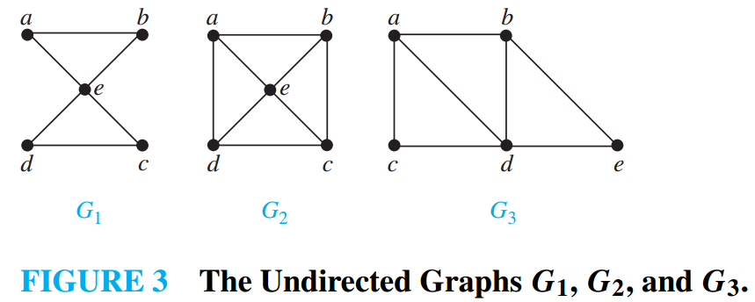
Problem - 1
Which of the undirected graphs in Figure 3 have an Euler circuit? Of those that do not, which have an Euler path?
Graph | Euler Path | E. Circuit
G₁ | 1 | 1
G₂ | 0 | 0
G₃ | 1 | 0

Slide 6
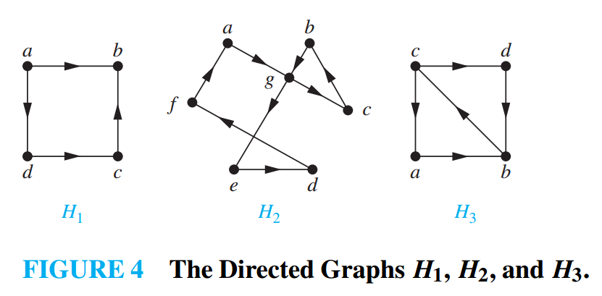
Problem - 2
Which of the undirected graphs in Figure 3 have an Euler circuit? Of those that do not, which have an Euler path?
Graph | Euler Path | E. Circuit
H₁ | 0 | 0
H₂ | 1 | 1
H₃ | 1 | 0

Slide 7
Euler path and circuit
Theorem 1
A connected multigraph with at least two vertices has an Euler circuit if and only if each of its vertices has even degree.
C
A
D
B

Slide 8
Euler path and circuit
Theorem 2
A connected multigraph has an Euler path but not an Euler circuit if and only if it has exactly two vertices of odd degree.
C
A
D
B

Slide 9
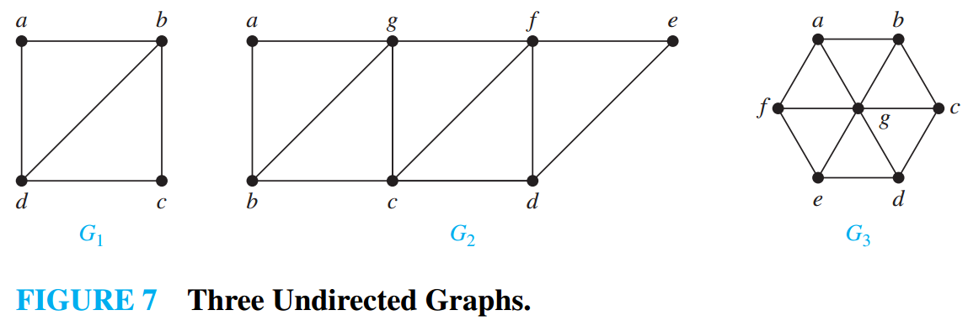
Problem - 3
Which graphs shown in Figure 7 have an Euler path?

Slide 10
Hamilton path and circuit
Definition
A simple path in a graph G that passes through every vertex exactly once is called a Hamilton path, and a simple circuit in a graph G that passes through every vertex exactly once is called a Hamilton circuit.

Slide 11
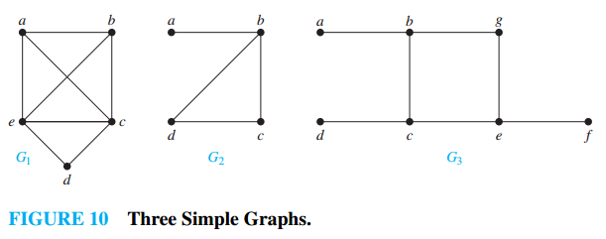
Problem - 4
Which of the simple graphs in Figure 10 have a Hamilton circuit or, if not, a Hamilton path?
Graph | H. Path | H. Circuit
G₁ | 1 | 1
G₂ | 1 | 0
G₃ | 0 | 0

Slide 12
Shortest Path Problem

Slide 13
Weighted Graph
Definition
Graphs that have a number assigned to each edge are called weighted graphs.
5
V₁
V₀
8
3
6
V₃
V₂

Slide 14
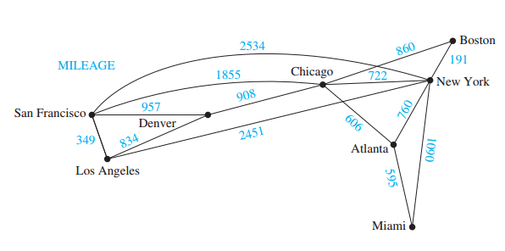
Weighted Graph

Slide 15
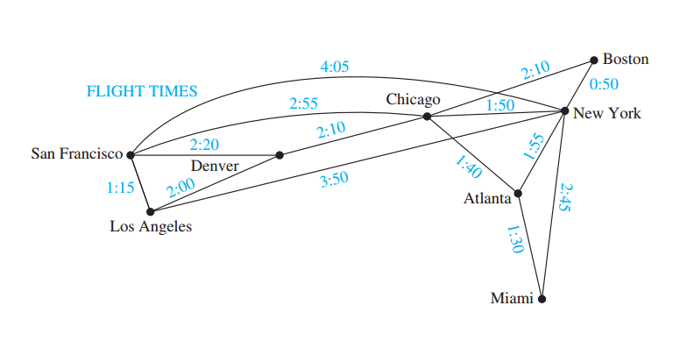
Weighted Graph

Slide 16
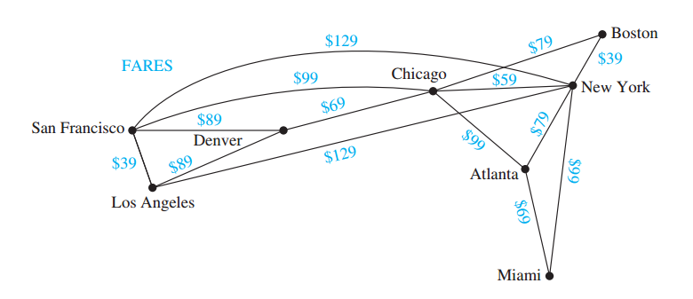
Weighted Graph

Slide 17
Any Questions?

